Slide 1
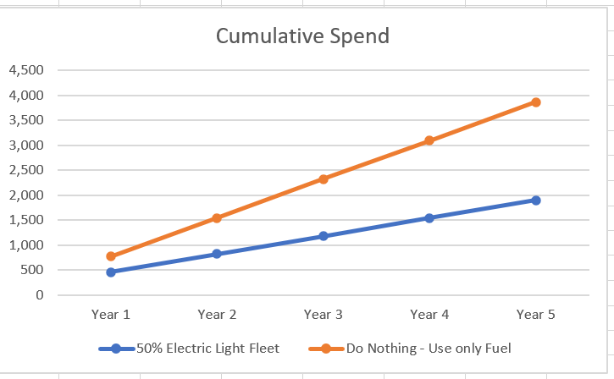

SCiN E-Mobility Project – Phase 1
INITIATIVE CHARTER – FAST TRACK INITIATIVE
Description of the initiative
Valuation of impact overview for PHC-I.A Fleet - fuel only.
Situation
Production & Man-hour losses in locations due to rationing of vehicles to reduce diesel & GHG emissions.
Fueling light fleet(sedan, pickup, SUV) in PHC operations alone cost $65K/month average.
Total scope 2&3 emissions from staff commute and Company fleet stand at an estimated 65tons of GHG/month.
Summary Project Benefits
Expected OPEX savings of ca. $1.9m in 5years[fuel only]
Annualized GHG abatement of ca. 1ktCO₂e.
EV charger provision in office location as EVP
Potential to replicate in all locations
Initiative description
Phase 1: Install 3 new charge points in PHC IA , 1 in a field location; buy 1 new company-owned 30-seater Electric Bus and1 Ex-rated van to showcase savings and encourage EV adoption by staff & teams.
Phase 2: Replace up to half of light fleet operational vehicles with electric models (Retaining the other half as ICE for contingency).
Install more chargers to meet demand.
Adoption of Electric Vehicles in SCiN provides the opportunity to reduce direct Opex of running operational vehicles by over 50%, improve production in the fields, achieve GHG abatement of ca. 1ktCO2e annually and act as Employee Value Proposition.
Key stakeholders
Project Sponsor:
Initiative lead: Simon Edache
Project Team:
Finance lead: TBD
Other key stakeholders:
Risks and mitigation
S/N | Risk | Mitigation
1 | Overloading of Facility power generation
2 | Limited inhouse competency on EV projects
3 | Damage to vehicles during charging
4 | Security of vehicle during charge
5 | Material lead time and procurement strategy
$Cash
GHG
EVP
EV Adoption
Cost
Project Duration: 6 months
4 chargers Cost $20k, 1 Electric Bus & 1 Van cost USD240k
Request: Provide budget support of USD260K for the SCiN E-Mobilty project phase 1 (4-Charging Stations & 2vehicles).
Notes:
Conclusion: The electric cars may have a slightly higher CAPEX but a much lower OPEX profile than the Do-Nothing scenario – with more than 60% reduction in direct OPEX. On consolidated cost basis, the electric solution is better off by 55%.

